Slide 1
MPI on Multicore Architectures using MPICH2
Darius Buntinas – buntinas@mcs.anl.gov

Slide 2
Outline
Using MPI on Multicore Systems
Single-Threaded MPI Programming
  MPICH2 Multicore Optimizations
Multithreaded MPI Programming
Allocating Processes/Threads to Cores
Binding Processes/Threads to Specific Cores
Application Study on Core Binding and I/O Interrupts
Profiling, Tracing and Debugging Tools

Slide 3
Typical Ways to Use MPI on Multicore Systems
process
One MPI process per core
  Each MPI process is a single thread
One MPI process per node
  MPI processes are multithreaded
  One thread per core
  aka Hybrid model
Some combination of the two
node
Dual-core processor

Slide 4
Scalability
MPI can scale to very large systems
  E.g. MPICH2 on 65K dual-core BlueGene/L nodes
But will an existing application scale?
  If it runs on 4K single-core nodes, it will run fine on 1K four-core nodes
  But will it run on 4K four-core nodes?
Hybrid programming model can help improve scalability
  Shared-memory/threads programming on nodes
  MPI across nodes

Slide 5
Single-Threaded MPI Programming
Pros
  Same paradigm developers are used to
  Existing codes can make use of multicore
  Easier to debug
Cons
  There may be a better shared-memory algorithm
  Possible duplication of large arrays

Slide 6
MPICH2 Features to Support Multicore Architechtures
Nemesis: New “multimethod” communication subsystem for MPICH2
  Optimized intranode and internode communication
Shared memory
Network
Process 0
Process 1
Process 2
Node 0
Node 1

Slide 7
MPICH2 Multicore Optimizations
Nemesis uses lock-free queues
  Scalable
    One receive queue per process
  Low latency
    Implemented using atomic assembly instructions: no lock overhead
    Optimized to reduce cache misses
MPICH2 performance on a 2.6 GHz dual Clovertown
  214 ns zero-byte one way MPI message latency
    < 500 ns for 512 byte

Slide 8
MPICH2 Large Message Optimizations
Copying large messages through a queue may not be optimal
  Bandwidth and CPU utilization
Mechanisms exist to avoid the extra copy for large messages
  Directly access the other process’s address space
    Windows allows this, or pcontrol in Unix
  Kernel copy
  Use a NIC
Nemesis’s LMT API allows implementers to take advantage of bulk transfer mechanisms
  Currently: uses double buffered copy
    Good for bandwidth, but uses two cores
MPICH2 performance on a 2.6 GHz dual Clovertown
  2 GBps throughput for large messages (5 GBps when in cache)

Slide 9
Multithreaded MPI Programming
Pros
  Hybrid programming model
  Use shared-memory algorithms where appropriate
  One copy of large array shared by all threads
Cons
  In general threaded programming can be difficult to write, debug and verify (e.g., using pthreads)
OpenMP and UPC make threaded programming easier
  Language constructs to parallelize loops, etc.

Slide 10
MPI Supported Thread Levels
MPI_THREAD_SINGLE
  Only one user thread is allowed
MPI_THREAD_FUNNELED
  May have one or more threads, but only the “main” thread may make MPI calls
MPI_THREAD_SERIALIZED
  May have one or more threads, but only one thread can make MPI calls at a time. It is the application developer’s responsibility to guarantee this.
MPI_THREAD_MULTIPLE
  May have one or more threads. Any thread can make MPI calls at any time (with certain conditions).
MPICH2 supports MPI_THREAD_MULTIPLE

Slide 11
Using Multiple Threads in MPI
The main thread must call MPI_Init_thread()
  App requests a thread level
  MPI returns the thread level actually provided
  These values need not be the same on every process
  Hint: Request only the level you need to avoid unnecessary overhead for higher thread levels.
MPI_Init_thread()
  Called in place of MPI_Init()
  Only the main thread should call this
  The main thread (and only the main thread) must call MPI_Finalize
    there is no MPI_Finalize_thread()
MPI does not provide routines to create threads
  That’s left to the user
    E.g., use pthreads OpenMP, etc

Slide 12
MPI Thread Programming Caveats
Multiple threads cannot block waiting on the same request
  MPI_Test from multiple threads is OK, but not MPI_Wait
A request can only be completed once
Collective calls on the same communicator must be called in the same order at all processes
  If collectives are called on different threads, the app developer must guarantee the correct order
  Collectives on different communicators can be reordered
Don’t cancel a thread while it’s in an MPI call

Slide 13
Allocating Processes/Threads to Cores
Typically: one process/thread per core
It may be beneficial to oversubscribe in some cases
  If a process/thread is blocking most of the time
  Examples:
    Communication thread with compute threads
    Master/slave
      Master process distributes work then waits for results
Caution: Some MPI implementations actively poll while waiting for a message
  Comm. Thread would compete for cycles with compute threads

Slide 14
Polling vs Blocking
Polling gives better communication performance
  But burns a processor without getting work done
Blocking introduces additional overhead
  System call overhead
    By the process blocking
    By the process signaling blocked process
  Context switch
How to reduce performance impact of blocking?
How to block waiting for a message from either shared-memory or network?

Slide 15
Blocking in MPICH2
Two options we’re evaluating
Option A – Poll for a while, then yield()
  Lower communication overhead
  Can still check network and shared-memory
  But still running once per timeslice, many such threads can add up
Option B – Poll for a while, then wait on a semaphore
  Better core utilization: we’re really blocking now
  But sender must signal a semaphore: system call
  If we’re blocking on a semaphore, how do we check the network?
    Create an internal thread which blocks on the network

Slide 16
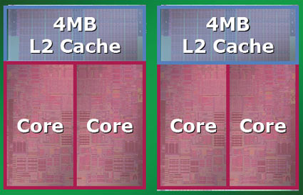
Binding Processes/Threads to Specific Cores
Processes/threads can be bound to one or
more cores
Which core to choose?
For best communication, locate threads that
do a lot of communication close together
  On same node → processor → cores sharing L2 cache
But cores on the same processor share cache and pins to frontside bus
  Might do better splitting up threads that do a lot of memory accesses
Bind the communication thread to one of the cores for the compute threads of the same process
I/O interrupt handling is statically mapped to one core

Slide 17
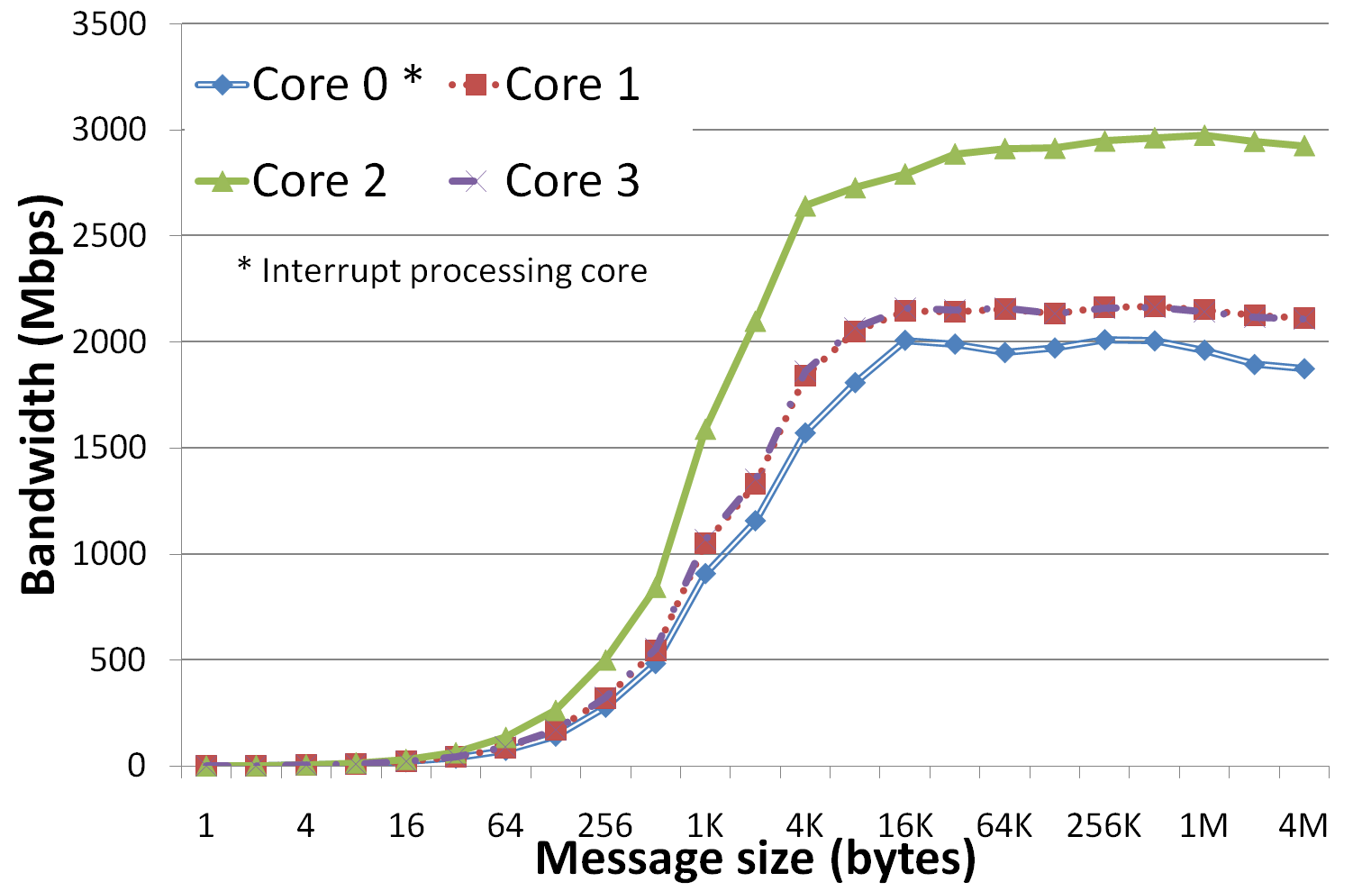
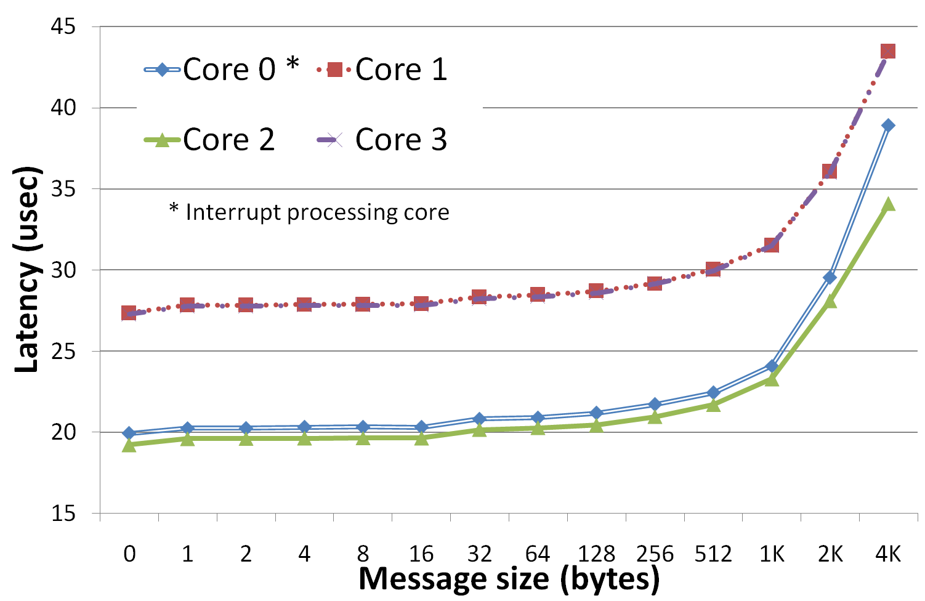
Effects of Statically Mapped I/O Interrupt Handling
Interrupt-based networks increase I/O interrupts
  E.g., TCP as opposed to iWARP or InfiniBand
Interrupt handling affects communication performance
G. Narayanaswamy, P. Balaji, and W. Feng, “An Analysis of 10-Gigabit Ethernet Protocol Stacks in Multicore Environments.” HotI, 2007.
  Two dual-socket dual-core Intel machines

Slide 18
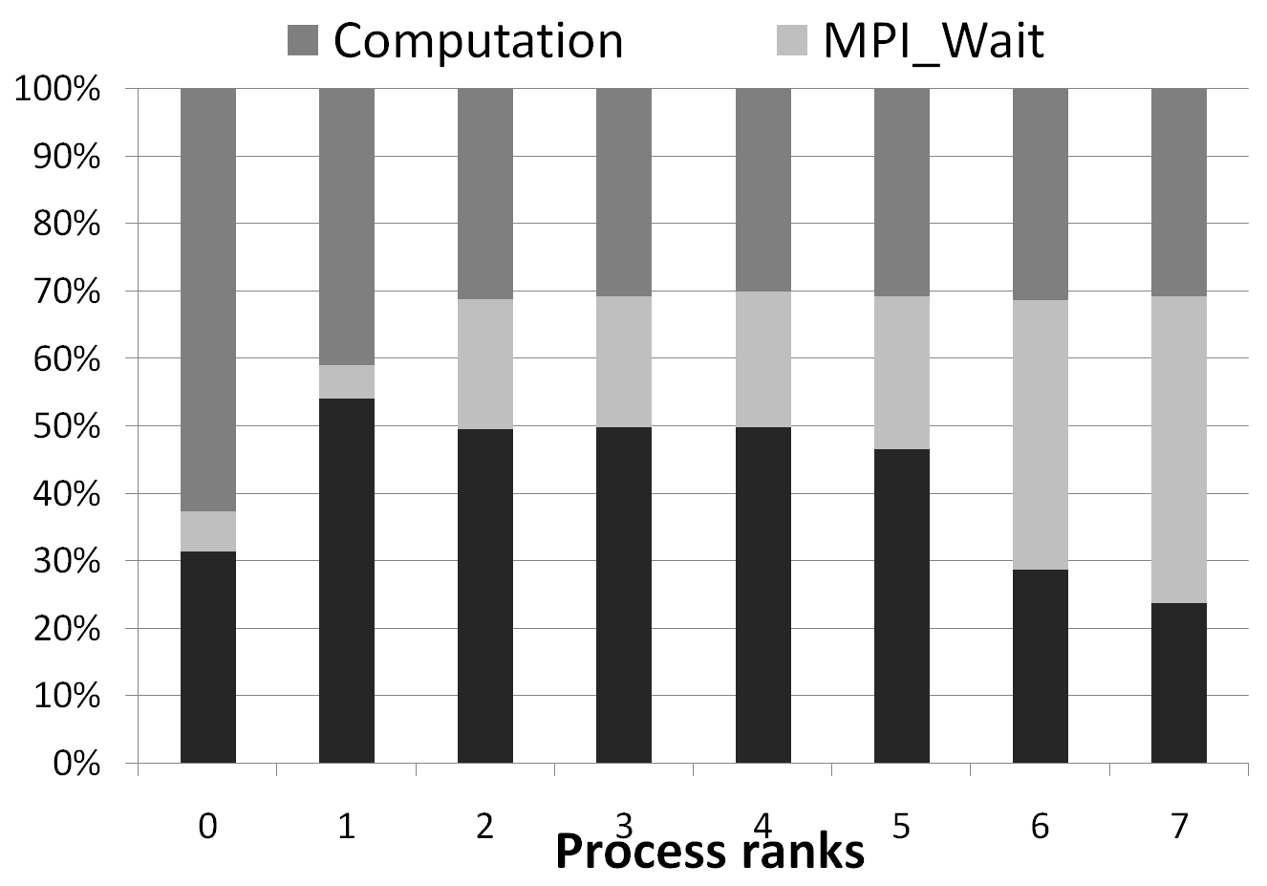
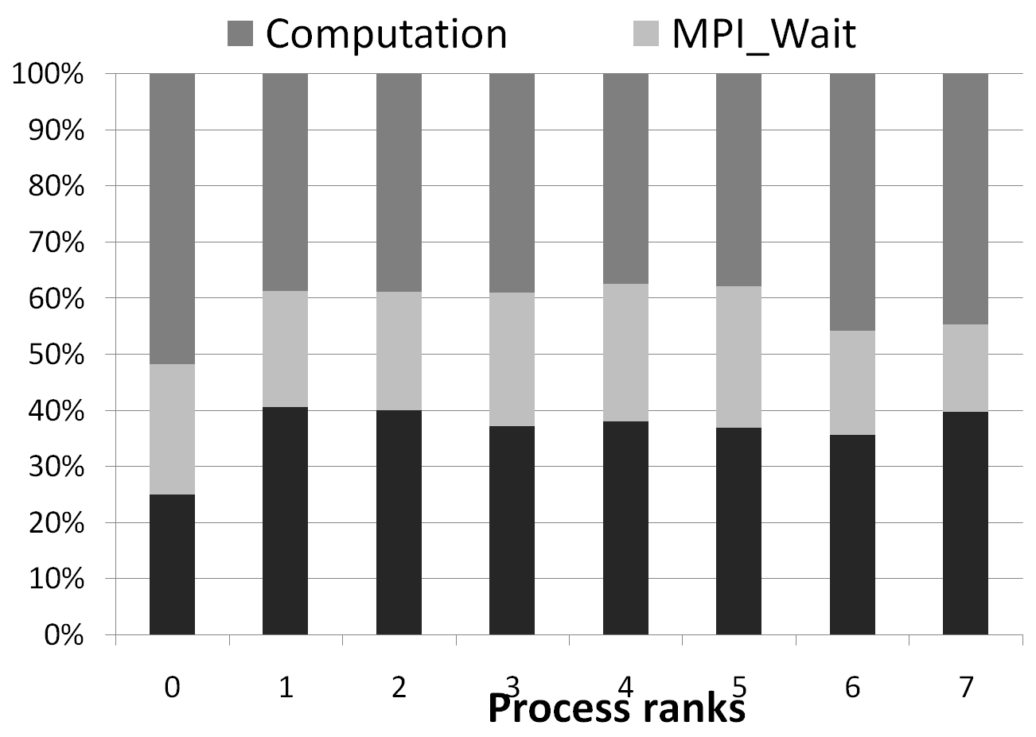
Rearranging Processes
Interrupts cause an imbalance in core performance
  Processes on interrupt-handling core will appear to run slower
Profile graphs of GROMACS
Configuration A’ swaps Process 0 on Core 0 with Process 6 on Core 3
Configuration A
Configuration A’

Slide 19
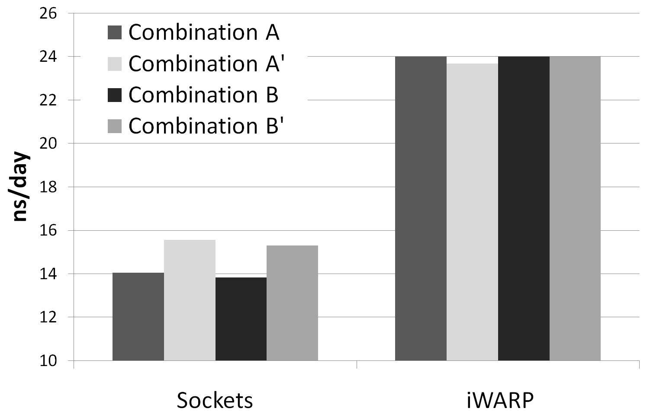
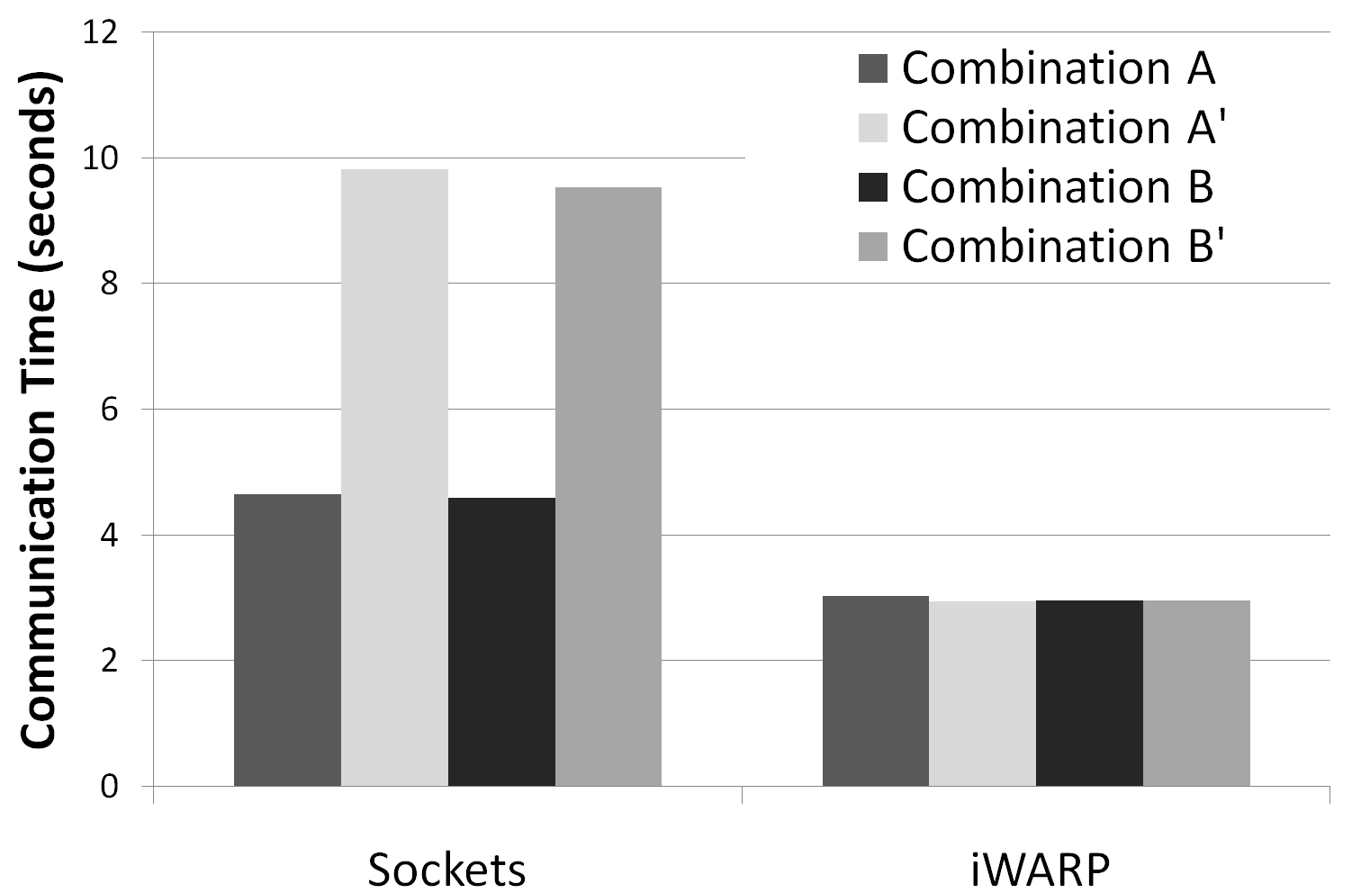
Impact on Application Performance
Rearranging the processes gives 11% improvement for GROMACS and 50% for LAMMPS
Note: GROMACS graph shows ns/day (higher is better) LAMMPS graph shows communication time (lower is better)
GROMACS
LAMMPS

Slide 20
Profiling and Tracing Tools
Tracing records a chronology of events
  Lots of data
  Good for seeing timing details
Profiling gives an overview of events (what happened but not when)
  More manageable data
  Good for identifying imbalance (computation, communication, etc)
Profiling tools
  IPM : Integrated Performance Monitoring (NERSC)
  FPMPI-2 (Argonne)
  TAU (University of Oregon)
Tracing and performance visualization tools
  Jumpshot (Argonne)

Slide 21
Debuggers and IDEs
Totalview
  Parallel debugger
  MPI and OpenMP
Eclipse with Parallel Tools Platform (PTP)
  IDE
  MPI and OpenMP artifact identification
  Integration with TAU
  Parallel debugger
  Job status monitoring

Slide 22
Summary
Using MPI on multicore
  One MPI process per core – fast communication (214 ns latency)
  Multithreaded – Hybrid model with OpenMP, UPC, pthreads
Allocating processes to cores
  Oversubscribing may improve performance
    If the MPI implementation blocks
Binding processes/threads to cores
  Processes “close” to each other get better communication performance
  “close” processes share more resources (cache, die pins)
  One core may handle more interrupts than the others
Choosing the correct binding can improve application performance

Slide 23
For More Information
Darius Buntinas
  buntinas@mcs.anl.gov
  http://www.mcs.anl.gov/~buntinas
MPICH2: http://www.mcs.anl.gov/mpi/mpich2
An Analysis of 10-Gigabit Ethernet Protocol Stacks in Multicore Environments paper: http://www.mcs.anl.gov/~balaji
IPM: http://ipm-hpc.sourceforge.net
FPMPI-2: http://www.mcs.anl.gov/fpmpi
TAU: http://www.cs.uoregon.edu/research/tau
Jumpshot: http://www-unix.mcs.anl.gov/perfvis
TotalView: http://www.totalviewtech.com
Eclipse PTP: http://www.eclipse.org/ptp

